Slide 1
CS 3502 Operating Systems Project 1
Kun Suo
Computer Science, Kennesaw State University
https://kevinsuo.github.io/

Slide 2
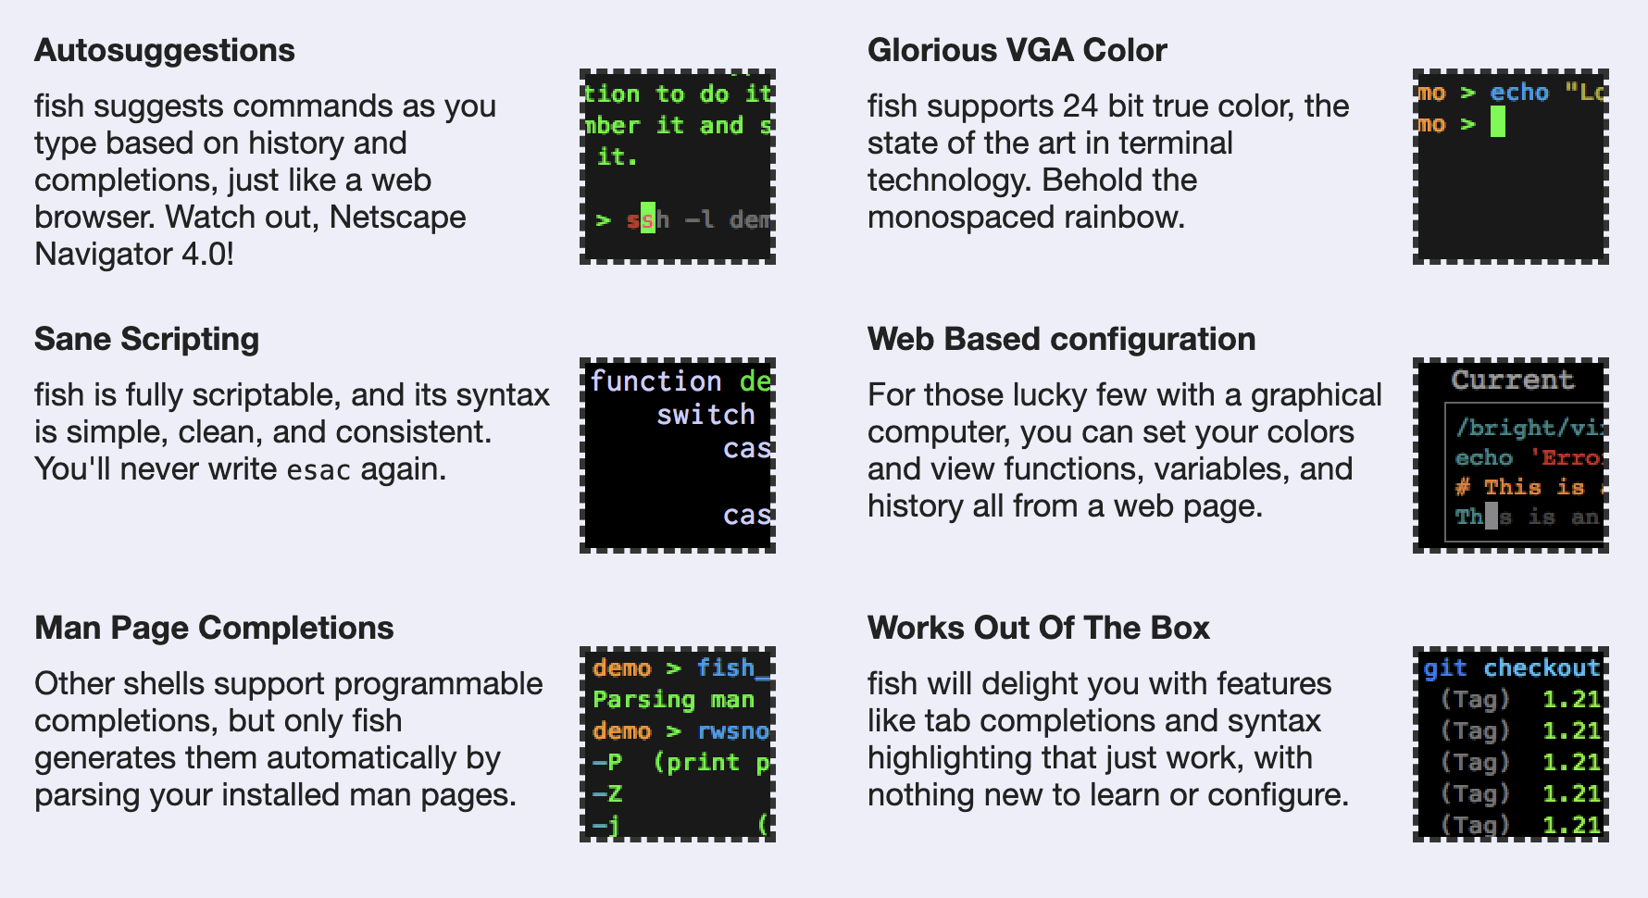
Command: fish
https://fishshell.com/

Slide 3
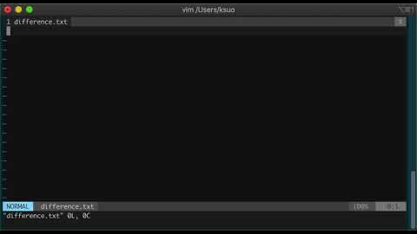
Command: diff
https://youtu.be/oj0zJzJmdSs
show the difference between two files:
$ diff -u original_file.c modified_file.c > result.txt

Slide 4
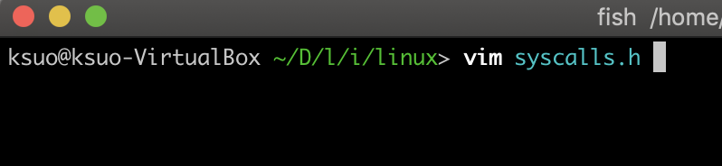
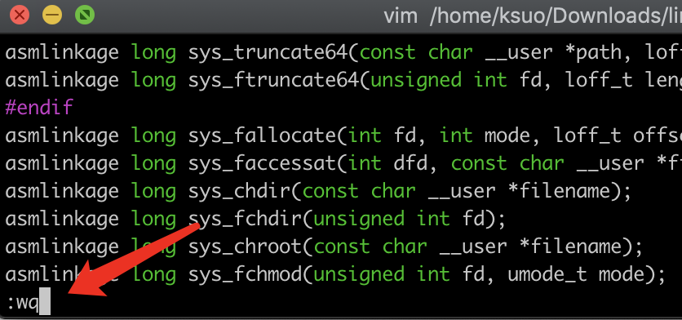
Project 1: No IDE, please use vim
Open a file
$ vim test.c
Close a file
Inside vim (after opening), press :q!
Inside vim (after opening), press :wq, changes saved
Exclamation mark means changes not save. Take care.
colon mark means menu.

Slide 5
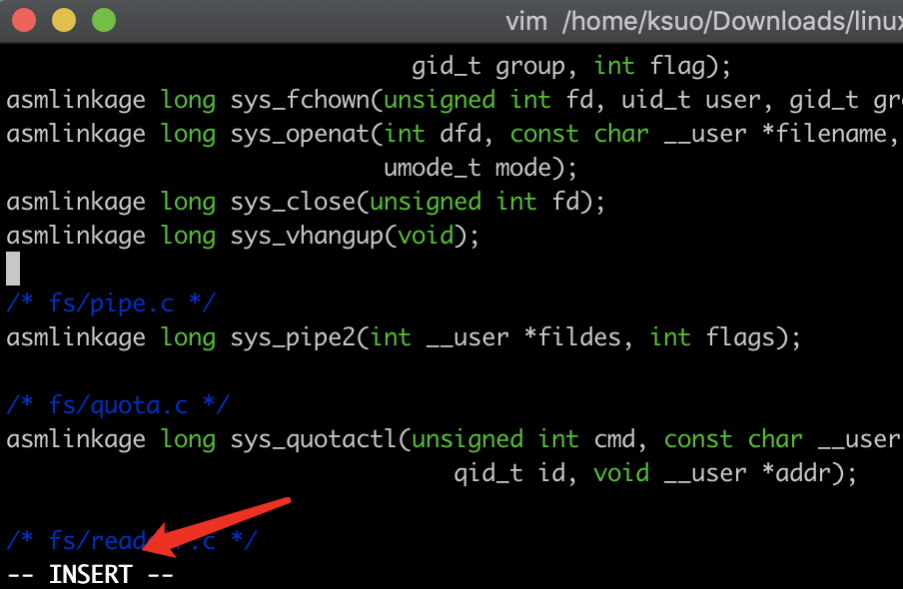
Project 1: No IDE, please use vim
Edit a file
Open a file
Press i (means enter the insert mode). then input your code
Press ESC to exit the insert mode
Close a file (:wq)

Slide 6
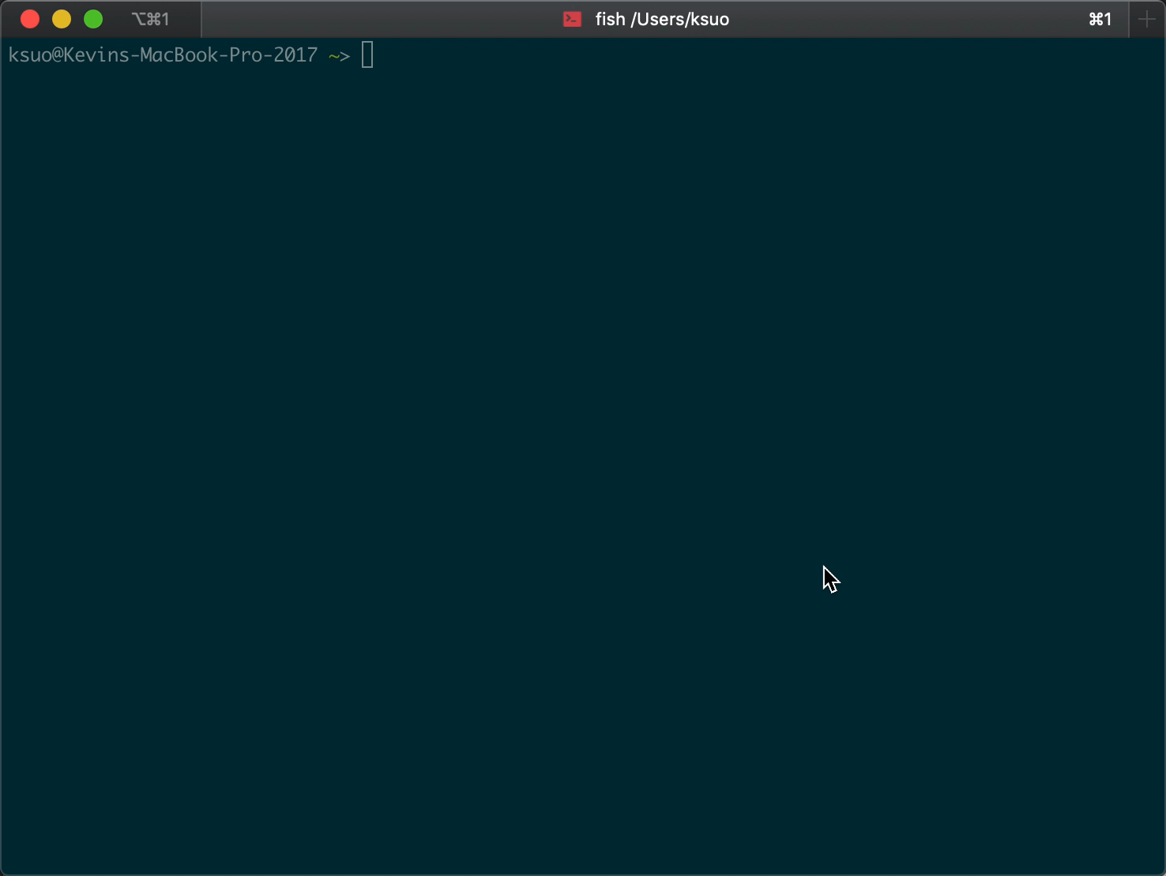
Project 1: No IDE, please use vim
https://youtu.be/rS0XZpLtVlo

Slide 7
Edit a file with vim
step 1: $ vim file
step 2: press i, enter insert mode; move the cursor to position and edit the context
step 3: after editing, press ESC to exit the insert mode to normal mode
step 4: press :wq to save what you edit and quit. If you do not want to save, press :q!

Slide 8
More about vim
A quick start guide for beginners to the Vim text editor
https://eastmanreference.com/a-quick-start-guide-for-beginners-to-the-vim-text-editor
Vim basics:
https://www.howtoforge.com/vim-basics
Learn the Basic Vim Commands [Beginners Guide]
https://www.youtube.com/watch?time_continue=265&v=ZEGqkam-3Ic

Slide 9
Outline
Assignment 0: create a VM and compile your kernel
Assignment 1: add a new system call into the Linux kernel
Assignment 2: Extend your new system call to print out the calling process’s information
Assignment 3: Extend your new system call to print out the information of an arbitrary process identified by its PID

Slide 10
How to build one ubuntu VM?
HostOS
Windows 10: https://www.youtube.com/watch?v=QbmRXJJKsvs
MacOS: https://www.youtube.com/watch?v=GDoCrfPma2k&t=321s

Slide 11
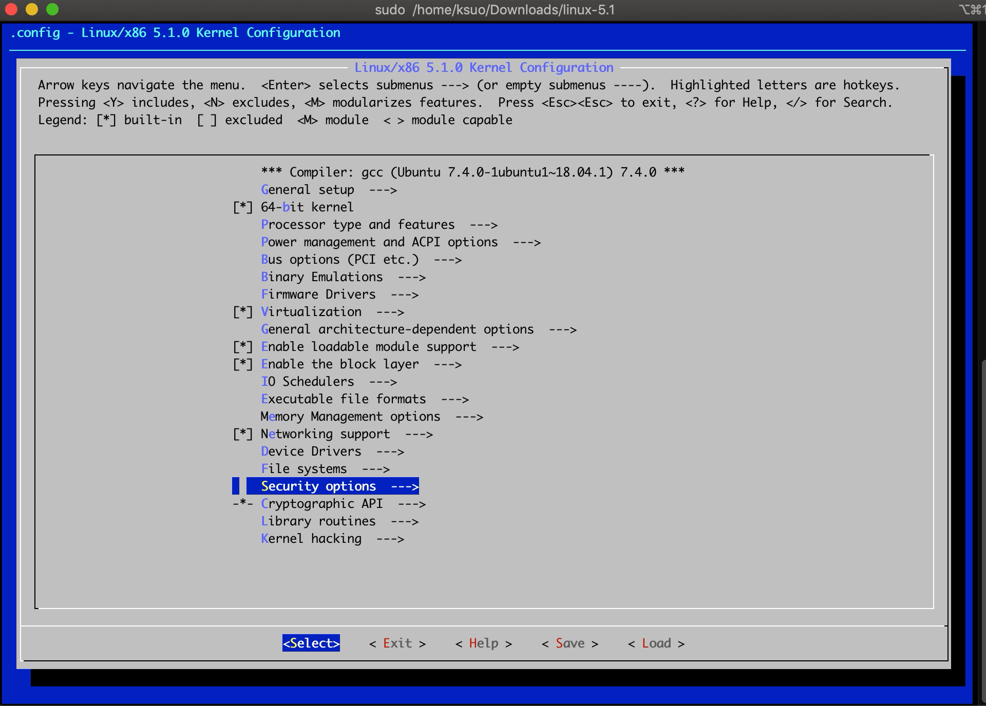
Project 1: menuconfig
https://youtu.be/UyOGF4UOoR0

Slide 12
Tips
Compile Linux kernel takes half to many hours, depending on machine speed
To save the time, you can compile it before you sleep
Run many commands in one:
$ sudo make; sudo make modules; sudo make modules_install; sudo make install

Slide 13
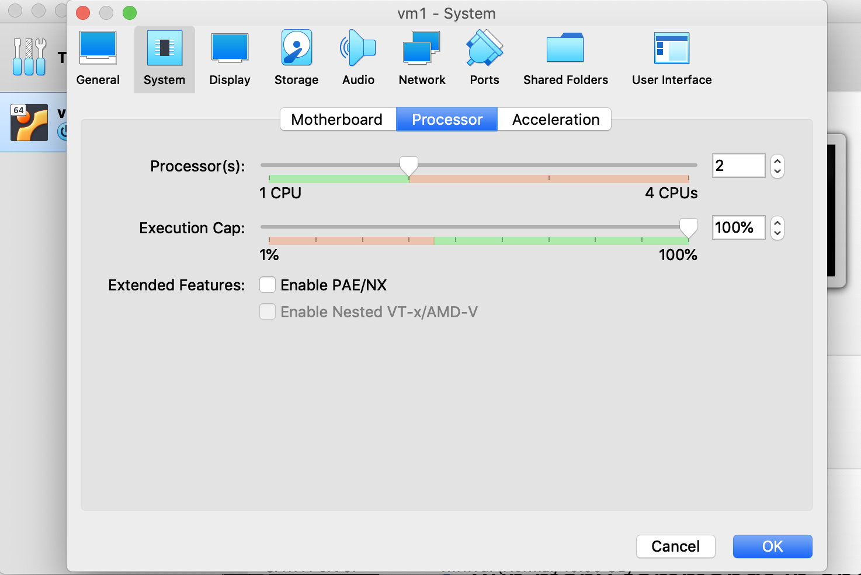
Tips
Set up more CPUs for VM
Make –j N, to accelerate compiling (N is your CPU number)

Slide 14
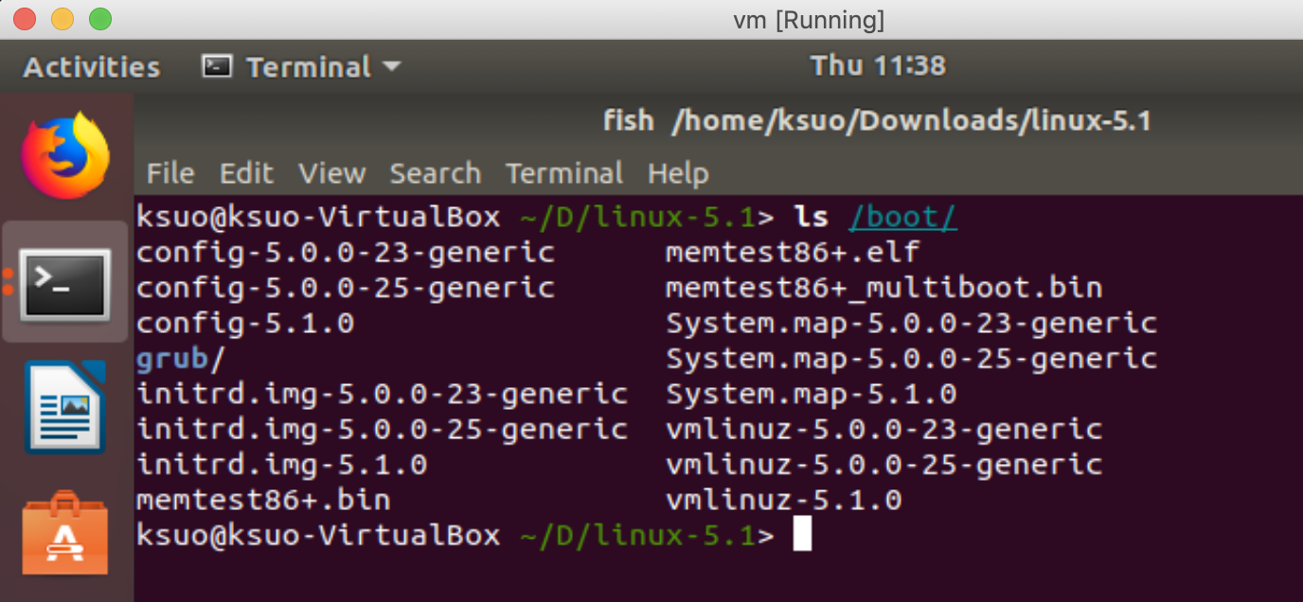
Where is my kernel?
$ ls /boot/
Initial ramdisk: loading a temporary root file system into memory. Used for startup.
Linux executable kernel image

Slide 15
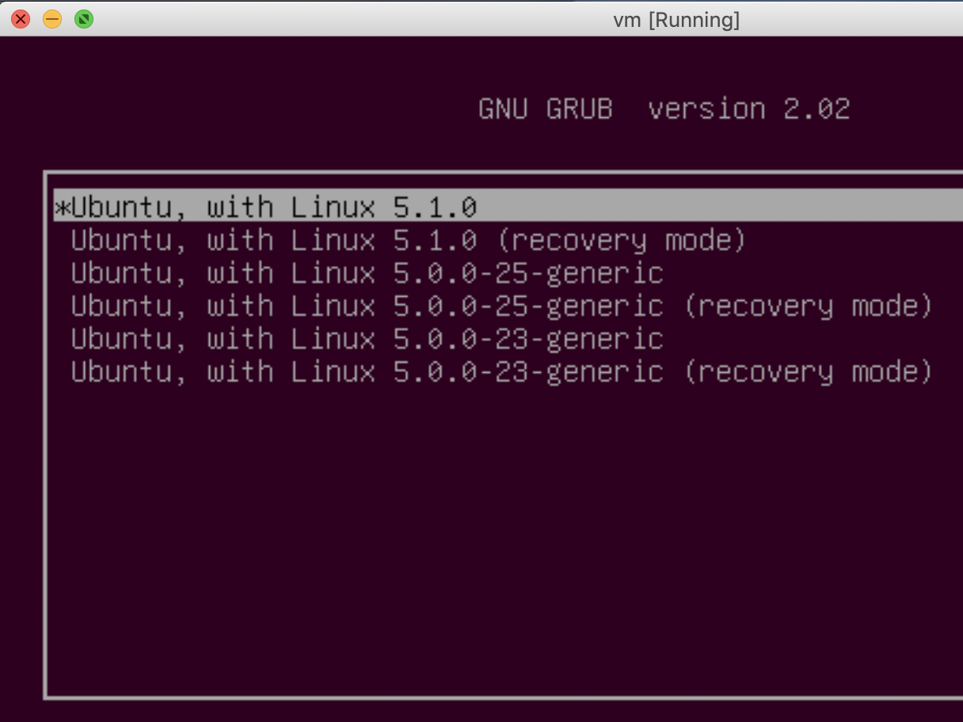
Which kernel to boot if there are many?
If you are using Ubuntu: change the grub configuration file:
$ sudo vim /etc/default/grub
Make the following changes:
GRUB_DEFAULT=0
GRUB_TIMEOUT=10
Then, update the grub entry:
$ sudo update-grub2
The OS boots by using the first kernel by default. You have 10 seconds to choose.

Slide 16
Which kernel to boot if there are many?
Immediately after the BIOS/UEFI splash screen during boot, with BIOS, quickly press and hold the Shift key, which will bring up the GNU GRUB menu. (If you see the Ubuntu logo, you've missed the point where you can enter the GRUB menu.)

Slide 17
What if my kernel crashed?
Your kernel could crash because you might bring in some kernel bugs
In the menu, choose the old kernel to boot the system
Fix your bug in the source code
Compile and reboot

Slide 18
Compile the kernel
download the kernel source code
unzip the file
use make menuconfig to create a config file
use make/make modules to compile the code
use make modules_install/make install to install the kernel
reboot the VM

Slide 19
Outline
Assignment 0: create a VM and compile your kernel
Assignment 1: add a new system call into the Linux kernel
Assignment 2: Extend your new system call to print out the calling process’s information
Assignment 3: Extend your new system call to print out the information of an arbitrary process identified by its PID

Slide 20
Define your system call
Step 1: register your system call
Step 2: declare your system call in the header file
Step 3: implement your system call
Step 4: write user level app to call it

Slide 21
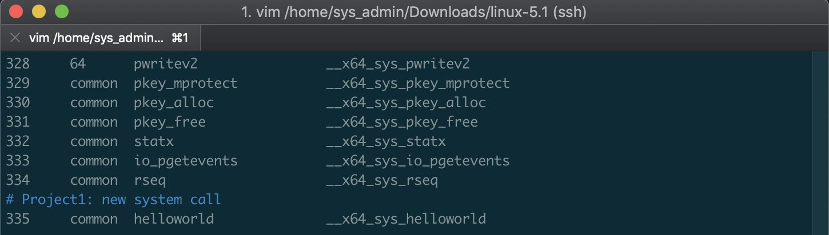
Step 1: register your system call
arch/x86/entry/syscalls/syscall_64.tbl
https://elixir.bootlin.com/linux/v5.0/source/arch/x86/entry/syscalls/syscall_64.tbl#L346

Slide 22
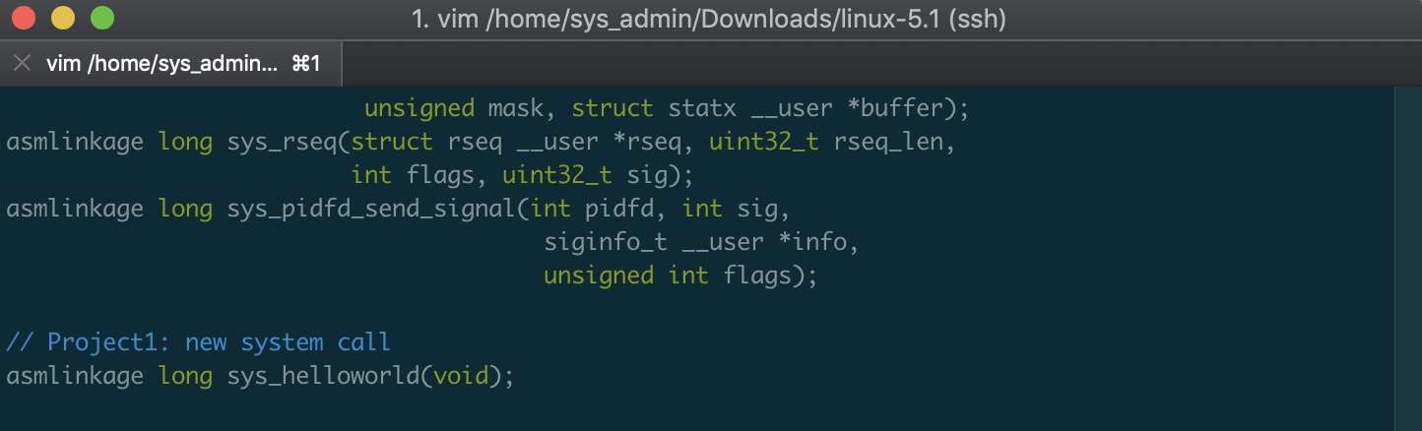
Step 2: declare your system call in the header file
include/linux/syscalls.h
https://elixir.bootlin.com/linux/v5.0/source/include/linux/syscalls.h

Slide 23
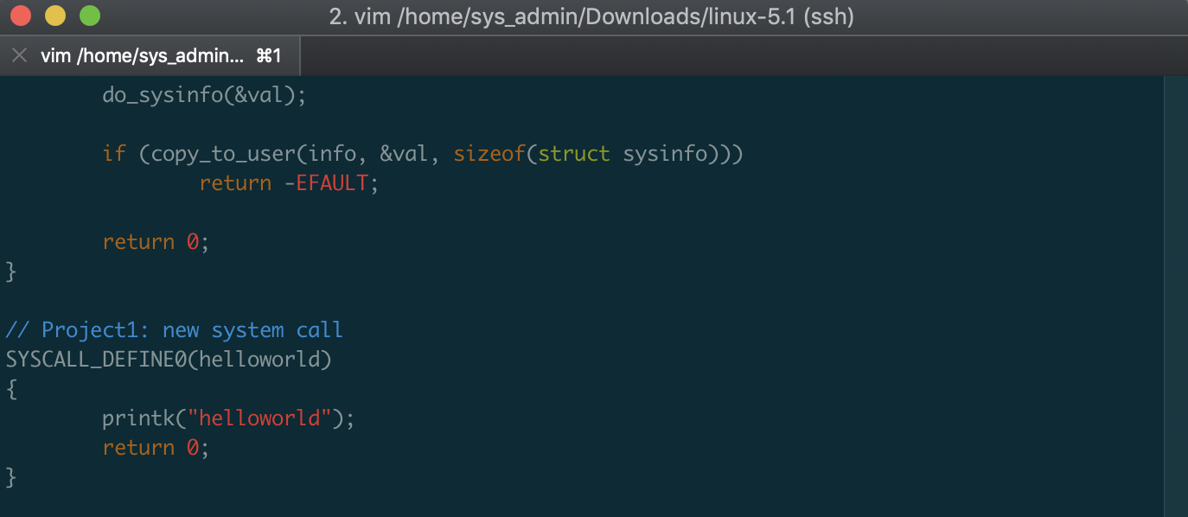
Step 3: implement your system call
kernel/sys.c
https://elixir.bootlin.com/linux/v5.0/source/kernel/sys.c#L402

Slide 24
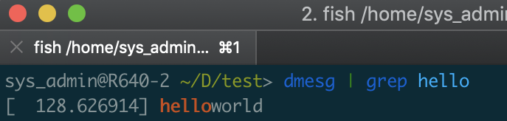
Step 4: write user level app to call it
test_syscall.c： ****************************************** #include <linux/unistd .h> #include <sys/syscall .h> #include <sys/types .h> #include <stdio .h> #define __NR_helloworld 335 int main(int argc, char *argv[]) { syscall (__NR_helloworld) ; return 0 ; } ******************************************
//If syscall needs parameter, then： //syscall (__NR_helloworld，a，b，c) ;
Compile and execute： $ gcc test_syscall.c -o test_syscall $ ./test_syscall
The test program will call the new system call and output a helloworld message at the tail of the output of dmesg (system log).

Slide 25
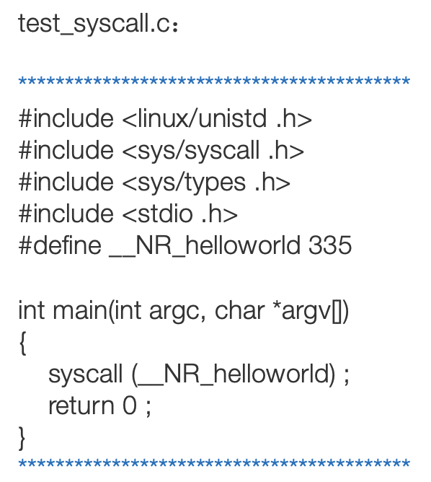
Put it all together
User space
Kernel space
Step 1: register
Step 2: declare
Step 4: user call it
Step 3: implementation

